Slide 1
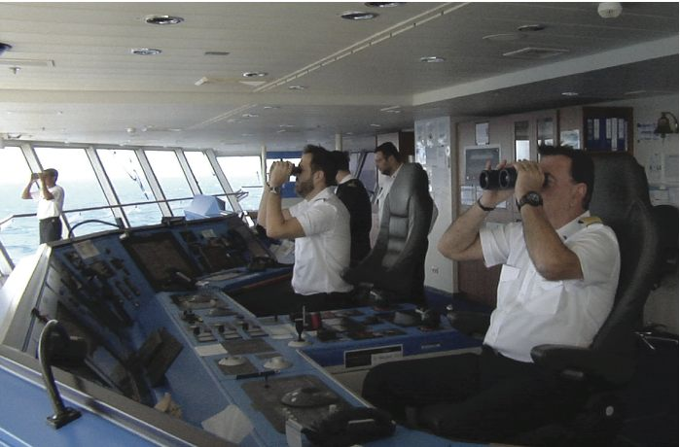
Operations and Productivity
1
PowerPoint presentation to accompany
Heizer, Render, Munson
Operations Management, Thirteenth Edition, Global Edition
Principles of Operations Management, Eleventh Edition
PowerPoint slides by Jeff Heyl

Slide 2
Outline
Global Company Profile: Hard Rock Cafe
What Is Operations Management?
Organizing to Produce Goods and Services
The Supply Chain
Why Study OM?
What Operations Managers Do

Slide 3
Outline - Continued
The Heritage of Operations Management
Operations for Goods and Services
The Productivity Challenge
Current Challenges in Operations Management
Ethics, Social Responsibility, and Sustainability

Slide 4

Operations Management at Hard Rock Cafe
First opened in 1971
Now – 23 hotels and 168 restaurants in over 68 countries
Rock music memorabilia
Creates value in the form of good food and entertainment
3,500+ custom meals per day in Orlando
How does an item get on the menu?
Role of the Operations Manager

Slide 5
Learning Objectives
When you complete this chapter you should be able to:
1.1 Define operations management
1.2 Identify the 10 strategic decisions of operations management
1.3 Identify career opportunities in operations management
1.4 Explain the distinction between goods and services

Slide 6
Learning Objectives
When you complete this chapter you should be able to:
1.5 Explain the difference between production and productivity
1.6 Compute single-factor productivity
1.7 Compute multifactor productivity
1.8 Identify the critical variables in enhancing productivity

Slide 7
What Is Operations Management?
Production is the creation of goods and services
Operations management (OM) is the set of activities that creates value in the form of goods and services by transforming inputs into outputs

Slide 8
Organizing to Produce Goods and Services
Essential functions:
1. Marketing – generates demand
2. Production/operations – creates the product
3. Finance/accounting – tracks how well the organization is doing, pays bills, collects the money

Slide 9
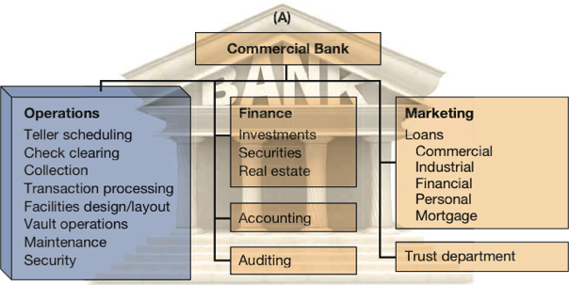
Organization Charts
Figure 1.1

Slide 10
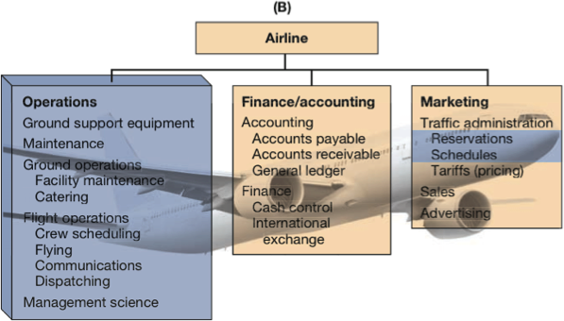
Organization Charts
Figure 1.1

Slide 11
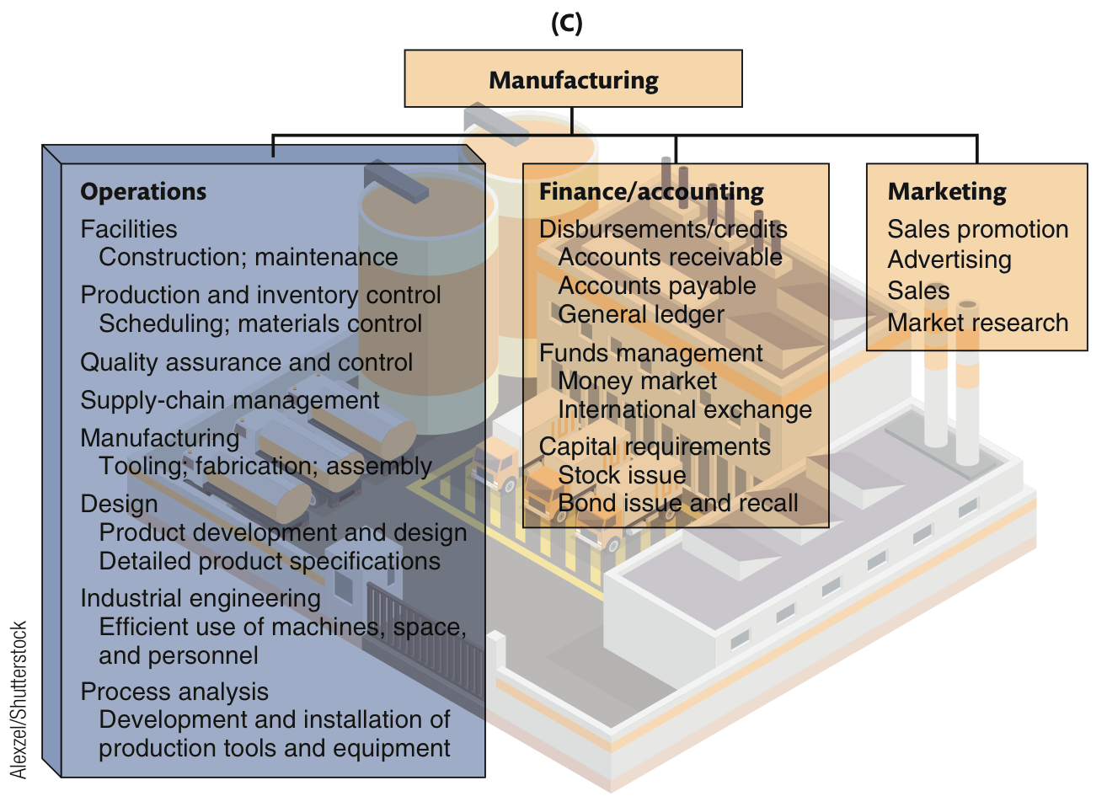
Organization Charts
Figure 1.1

Slide 12



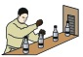
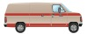
The Supply Chain
A global network of organizations and activities that supplies a firm with goods and services
Members of the supply chain collaborate to achieve high levels of customer satisfaction, efficiency and competitive advantage
Figure 1.2
Farmer Syrup Bottler Distributor Retailer
producer

Slide 13
Why Study OM?
OM is one of three major functions of any organization; we want to study how people organize themselves for productive enterprise
We want (and need) to know how goods and services are produced
We want to understand what operations managers do
OM is such a costly part of an organization

Slide 14
Options for Increasing Contribution
TABLE 1.1
 |  |  |  |  | MARKETING OPTION |  |  | FINANCE/ ACCOUNTING OPTION |  |  | OM OPTION
 |  | CURRENT |  |  | INCREASE SALES REVENUE 50% |  |  | REDUCE FINANCE COSTS 50% |  |  | REDUCE PRODUCTION COSTS 20%
Sales |  |  | $100,000 |  |  | $150,000 |  |  | $100,000 |  |  | $100,000
Cost of goods |  |  | –80,000 |  |  | –120,000 |  |  | –80,000 |  |  | –64,000
Gross margin |  |  | 20,000 |  |  | 30,000 |  |  | 20,000 |  |  | 36,000
Finance costs |  |  | –6,000 |  |  | –6,000 |  |  | –3,000 |  |  | –6,000
Subtotal |  |  | 14,000 |  |  | 24,000 |  |  | 17,000 |  |  | 30,000
Taxes at 25% |  |  | –3,500 |  |  | –6,000 |  |  | –4,250 |  |  | –7,500
Contribution |  |  | $ 10,500 |  |  | $ 18,000 |  |  | $ 12,750 |  |  | $ 22,500

Slide 15

What Operations Managers Do
Basic Management Functions
Planning
Organizing
Staffing
Leading
Controlling

Slide 16
Ten Strategic Decisions
TABLE 1.2
DECISION |  | CHAPTER(S)
1. Design of goods and services |  | 5, Supplement 5
2. Managing quality |  | 6, Supplement 6
3. Process and capacity strategy |  | 7, Supplement 7
4. Location strategy |  | 8
5. Layout strategy |  | 9
6. Human resources and job design |  | 10
7. Supply-chain management |  | 11, Supplement 11
8. Inventory management |  | 12, 14, 16
9. Scheduling |  | 13, 15
10. Maintenance |  | 17

Slide 17
The Strategic Decisions
Design of goods and services
Defines what is required of operations
Product design determines cost, quality, sustainability and human resources
Managing quality
Determine the customer’s quality expectations
Establish policies and procedures to identify and achieve that quality
Table 1.2 (cont.)

Slide 18
The Strategic Decisions
Process and capacity design
How is a good or service produced?
Commits management to specific technology, quality, human resources, and investments
Location strategy
Nearness to customers, suppliers, and talent
Considering costs, infrastructure, logistics, and government
Table 1.2 (cont.)

Slide 19
The Strategic Decisions
Layout strategy
Integrate capacity needs, personnel levels, technology, and inventory
Determine the efficient flow of materials, people, and information
Human resources and job design
Recruit, motivate, and retain personnel with the required talent and skills
Integral and expensive part of the total system design
Table 1.2 (cont.)
Notes:
Using this and subsequent slides, you might go through in more detail the decisions of Operations Management. While greater detail is provided by these slides than the earlier one, you may still decide to have the students contribute examples from their own experience.

Slide 20
The Strategic Decisions
Supply chain management
Integrate supply chain into the firm’s strategy
Determine what is to be purchased, from whom, and under what conditions
Inventory management
Inventory ordering and holding decisions
Optimize considering customer satisfaction, supplier capability, and production schedules
Table 1.2 (cont.)

Slide 21
The Strategic Decisions
Scheduling
Determine and implement intermediate- and short-term schedules
Utilize personnel and facilities while meeting customer demands
Maintenance
Consider facility capacity, production demands, and personnel
Maintain a reliable and stable process
Table 1.2 (cont.)

Slide 22
Where are the OM Jobs?
Introducing new technologies and methods
Improving facility location and space utilization
Defining and implementing operations strategy
Improving response time
Developing people and teams
Improving customer service
Managing quality
Managing and controlling inventory
Enhancing productivity

Slide 23
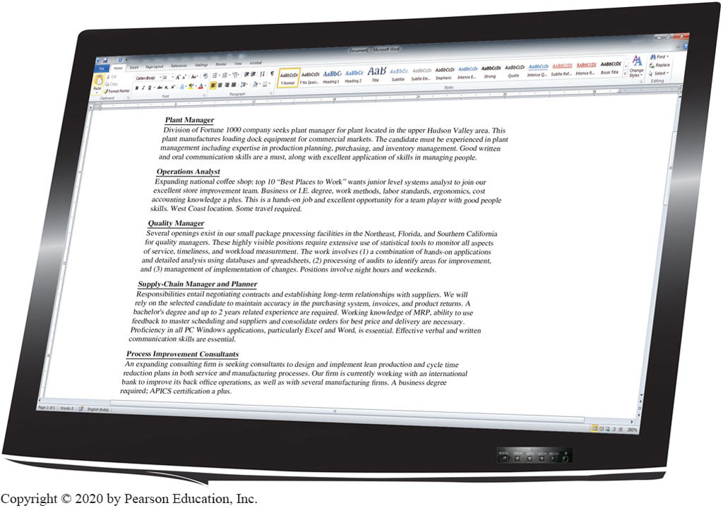
Opportunities
Figure 1.3

Slide 24
Certifications
APICS, the Association for Operations Management
American Society for Quality (ASQ)
Institute for Supply Management (ISM)
Project Management Institute (PMI)
Council of Supply Chain Management Professionals
Chartered Institute of Procurement and Supply (CIPS)

Slide 25
Significant Events in OM
Figure 1.4

Slide 26
Eli Whitney
Born 1765; died 1825
In 1798, received government contract to make 10,000 muskets
Showed that machine tools could make standardized parts to exact specifications
Musket parts could be used in any musket

Slide 27
Frederick W. Taylor
Born 1856; died 1915
Known as ‘father of scientific management’
In 1881, as chief engineer for Midvale Steel, studied how tasks were done
Began first motion and time studies
Created efficiency principles

Slide 28
Taylor’s Principles
Management Should Take More Responsibility for:
Matching employees to right job
Providing the proper training
Providing proper work methods and tools
Establishing legitimate incentives for work to be accomplished

Slide 29
Frank and Lillian Gilbreth
Frank (1868-1924); Lillian (1878-1972)
Husband and wife engineering team
Further developed work measurement methods
Applied efficiency methods to their home and 12 children!
Book and Movie: “Cheaper by the Dozen,” “Bells on Their Toes”

Slide 30
Henry Ford
Born 1863; died 1947
In 1903, created Ford Motor Company
In 1913, first used moving assembly line to make Model T
Unfinished product moved by conveyor past work station
Paid workers very well for 1911 ($5/day!)

Slide 31
W. Edwards Deming
Born 1900; died 1993
Engineer and physicist
Credited with teaching Japan quality control methods in post-WW2
Used statistics to analyze process
His methods involve workers in decisions

Slide 32
OM Relies on Contributions From
Industrial engineering
Statistics
Management
Analytics
Economics
Physical sciences
Information technology

Slide 33
Operations for Goods and Services
Services – Economic activities that typically produce an intangible product (such as education, entertainment, lodging, government, financial, and health services)

Slide 34
Operations for Goods and Services
Manufacturers produce tangible product, services often intangible
Operations activities are performed in both manufacturing and services
Distinction not always clear
Few pure services

Slide 35
Differences Between Goods and Services
TABLE 1.3
CHARACTERISTICS OF SERVICES |  | CHARACTERISTICS OF GOODS
Intangible: Ride in an airline seat |  | Tangible: The seat itself
Produced and consumed simultaneously: Beauty salon produces a haircut that is consumed as it is produced |  | Product can usually be kept in inventory (beauty care products)
Unique: Your investments and medical care are unique |  | Similar products produced (iPods)
High customer interaction: Often what the customer is paying for (consulting, education) |  | Limited customer involvement in production
Inconsistent product definition: Auto Insurance changes with age and type of car |  | Product standardized (iPhone)
Often knowledge based: Legal, education, and medical services are hard to automate |  | Standard tangible product tends to make automation feasible
Services dispersed: Service may occur at retail store, local office, house call, or via Internet. |  | Product typically produced at a fixed facility
Quality may be hard to evaluate: Consulting, education, and medical services |  | Many aspects of quality for tangible products are easy to evaluate (strength of a bolt)
Reselling is unusual: Musical concert or medical care |  | Product often has some residual value

Slide 36
U.S. Agriculture, Manufacturing, and Service Employment
100 -
80 –
60 –
40 –
20 –
0 .
Figure 1.5
Percent of Workforce
|
|
|
|
|
|
|
|
|
1825
1875
1925
1975
2025 (est.)
1800
1850
1900
1950
2000
Agriculture Services Manufacturing

Slide 37
Organizations in Each Sector
TABLE 1.4
SECTOR |  | EXAMPLE | PERCENT OF ALL JOBS
Service Sector
Education, Medical, Other Trade (retail, wholesale), Transportation Information, Publishers, Broadcast Professional, Legal, Business Services, Associations Finance, Insurance, Real Estate Food, Lodging, Entertainment Public Administration |  | San Diego State University, Arnold Palmer Hospital Walgreen's, Walmart, Nordstrom, Alaska Airlines IBM, Bloomberg, Pearson, ESPN Snelling and Snelling, Waste Management, Inc., American Medical Association, Ernst & Young Citicorp, American Express, Prudential, Aetna Olive Garden, Motel 6, Walt Disney U.S., State of Alabama, Cook County | 16.2 17.1 1.8 17.0 9.6 10.0 14.2 |  | 85.9
Manufacturing Sector |  | General Electric, Ford, U.S. Steel, Intel |  |  | 7.9
Construction Sector |  | Bechtel, McDermott |  |  | 4.3
Agriculture |  | King Ranch |  |  | 1.5
Mining Sector |  | Homestake Mining |  |  | .4
Grand Total |  |  |  |  | 100.0

Slide 38
Service Pay
Perception that services are low-paying
42% of service workers receive above average wages
14 of 33 service industries pay below average
Retail trade pays only 61% of national average
Overall average wage is 96% of the average

Slide 39
Productivity Challenge
Productivity is the ratio of outputs (goods and services) divided by the inputs (resources such as labor and capital)
The objective is to improve productivity!
Important Note!
Production is a measure of output only and not a measure of efficiency

Slide 40
The Economic System
Inputs
Transformation
Outputs
Labor, capital, management
The U.S. economic system transforms inputs to outputs at about an annual 2.5% increase in productivity per year. The productivity increase is the result of a mix of capital (38% of 2.5%), labor (10% of 2.5%), and management (52% of 2.5%).
Goods and services
Feedback loop
Figure 1.6

Slide 41
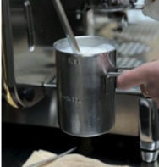
Improving Productivity at Starbucks
A team of 10 analysts continually look for ways to shave time. Some improvements:
Stop requiring signatures on credit card purchases under $25 |  | Saved 8 seconds per transaction
Change the size of the ice scoop |  | Saved 14 seconds per drink
New espresso machines |  | Saved 12 seconds per shot

Slide 42
Improving Productivity at Starbucks
A team of 10 analysts continually look for ways to shave time. Some improvements:
Operations improvements have helped Starbucks increase yearly revenue per outlet by $250,000 to $1,000,000.
Productivity has improved by 27%, or about 4.5% per year.
Stop requiring signatures on credit card purchases under $25 |  | Saved 8 seconds per transaction
Change the size of the ice scoop |  | Saved 14 seconds per drink
New espresso machines |  | Saved 12 seconds per shot

Slide 43
Productivity
Units produced
Input used
Productivity =
Measure of process improvement
Represents output relative to input
Only through productivity increases can our standard of living improve

Slide 44
Productivity Calculations
Labor Productivity
Units produced
Labor-hours used
Productivity =
1,000
250
= = 4 units/labor-hour
One resource input ⇨ single-factor productivity

Slide 45
Multi-Factor Productivity
Output
Labor + Material + Energy + Capital + Miscellaneous
Multifactor =
Also known as total factor productivity
Output and inputs are often expressed in dollars
Multiple resource inputs ⇨ multi-factor productivity

Slide 46
Collins Title Productivity
Old System:
Staff of 4 works 8 hrs/day 8 titles/day
Payroll cost = $640/day Overhead = $400/day
8 titles/day
32 labor-hrs
Old labor productivity
=
= .25 titles/labor-hr

Slide 47
Collins Title Productivity
Old System:
Staff of 4 works 8 hrs/day 8 titles/day
Payroll cost = $640/day Overhead = $400/day
New System:
14 titles/day Overhead = $800/day
8 titles/day
32 labor-hrs
Old labor productivity
=
= .25 titles/labor-hr
14 titles/day
32 labor-hrs
New labor productivity
=
= .4375 titles/labor-hr

Slide 48
Collins Title Productivity
Old System:
Staff of 4 works 8 hrs/day 8 titles/day
Payroll cost = $640/day Overhead = $400/day
New System:
14 titles/day Overhead = $800/day
8 titles/day
$640 + 400
Old multifactor productivity
=
= .0077 titles/dollar

Slide 49
Collins Title Productivity
Old System:
Staff of 4 works 8 hrs/day 8 titles/day
Payroll cost = $640/day Overhead = $400/day
New System:
14 titles/day Overhead = $800/day
8 titles/day
$640 + 400
Old multifactor productivity
=
= .0077 titles/dollar
14 titles/day
$640 + 800
New multifactor productivity
=
= .0097 titles/dollar

Slide 50
Measurement Problems
1. Quality may change while the quantity of inputs and outputs remains constant
2. External elements may cause an increase or decrease in productivity
3. Precise units of measure may be lacking

Slide 51
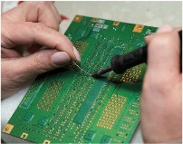
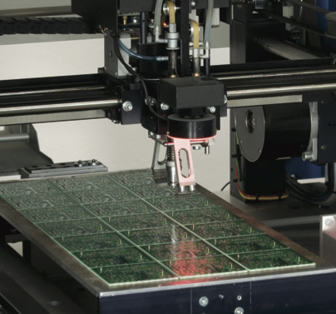
Productivity Variables
1. Labor - contributes about 10% of the annual increase
2. Capital - contributes about 38% of the annual increase
3. Management - contributes about 52% of the annual increase

Slide 52
Key Variables for Improved Labor Productivity
Basic education appropriate for the labor force
Diet of the labor force
Social overhead that makes labor available
Challenge is in maintaining and enhancing skills in the midst of rapidly changing technology and knowledge

Slide 53
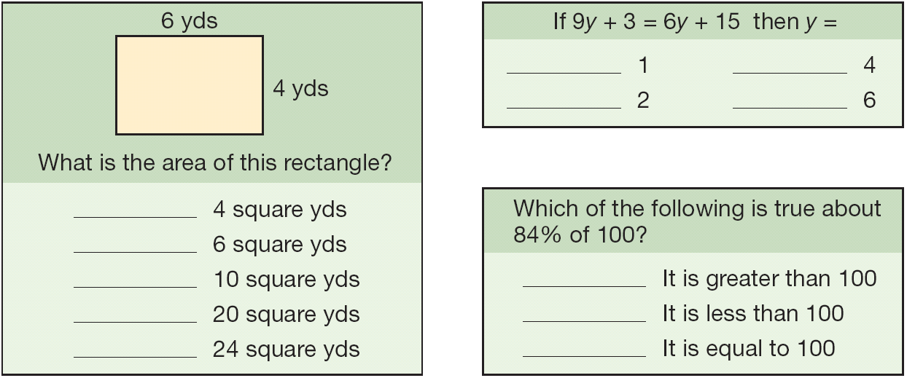
Labor Skills
About half of the 17-year-olds in the U.S. cannot correctly answer questions of this type
Figure 1.7

Slide 54

Capital
10
8
6
4
2
0
Percent increase in productivity
10 15 20 25 30 35
Percentage investment

Slide 55
Management
Ensures labor and capital are effectively used to increase productivity
Use of knowledge
Application of technologies
Knowledge societies
Labor has migrated from manual work to technical and information-processing tasks
More effective use of technology, knowledge, and capital

Slide 56
Productivity in the Service Sector
Productivity improvement in services is difficult because:
Typically labor intensive
Frequently focused on unique individual attributes or desires
Often an intellectual task performed by professionals
Often difficult to mechanize and automate
Often difficult to evaluate for quality

Slide 57
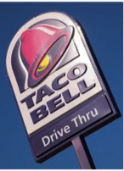
Productivity at Taco Bell
Improvements:
Revised the menu
Designed meals for easy preparation
Shifted some preparation to suppliers
Efficient layout and automation
Training and employee empowerment
New water and energy saving grills

Slide 58
Productivity at Taco Bell
Results:
Preparation time cut to 8 seconds
Management span of control increased from 5 to 30
In-store labor cut by 15 hours/day
Floor space reduced by more than 50%
Stores average 164 seconds/customer from drive-up to pull-out
Water- and energy-savings grills conserve 300 million gallons of water and 200 million KwH of electricity each year
Green-inspired cooking method saves 5,800 restaurants $17 million per year
Improvements:

Slide 59
Current Challenges in OM
Globalization
Supply-chain partnering
Sustainability
Rapid product development
Mass customization
Lean operations

Slide 60
Ethics, Social Responsibility, and Sustainability
Challenges facing operations managers:
Develop and produce safe, high-quality green products
Train, retrain, and motivate employees in a safe workplace
Honor stakeholder commitments

Slide 61
Ethics, Social Responsibility, and Sustainability
Stakeholders
Those with a vested interest in an organization, including customers, distributors, suppliers, owners, lenders, employees, and community members.
Challenges facing operations managers:
Develop and produce safe, high-quality green products
Train, retrain, and motivate employees in a safe workplace
Honor stakeholder commitments

Slide 62
